Slide 1
Radar Musical Instrument MATLAB GUI
Josiah W. Smith
Summer 2020

Slide 2
Prerequisite Software
Install TI mmWave Studio 2.1.0.1
Install TI mmWave Studio 1.0.0.0 for ES2.0 firmware
Install TI DFP 1.2.5.1 for ES3.0 firmware

Slide 3
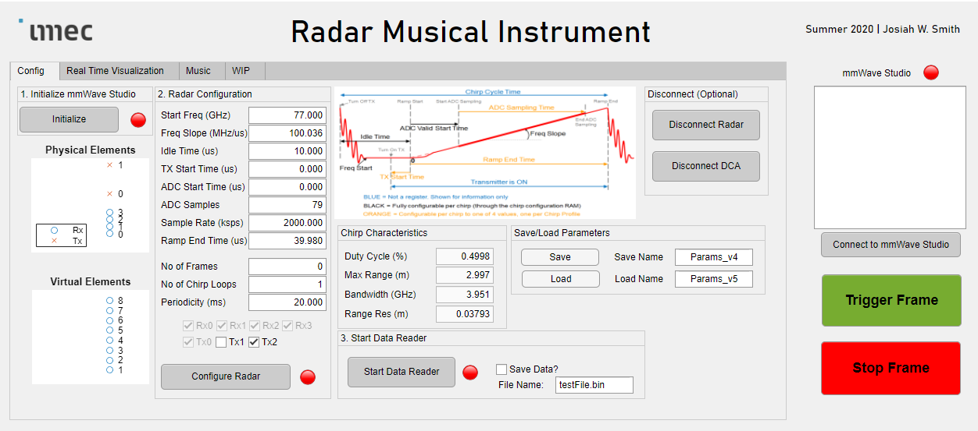
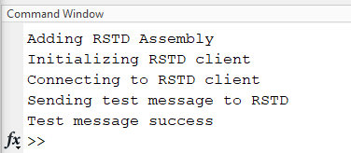
Step 1: Connect to mmWave Studio
- Now we can control mmWave Studio
If it fails or stalls:
Check the dll
Try another dll from a different version of mmWave Studio
Before you start, open mmWave Studio
Success!

Slide 4
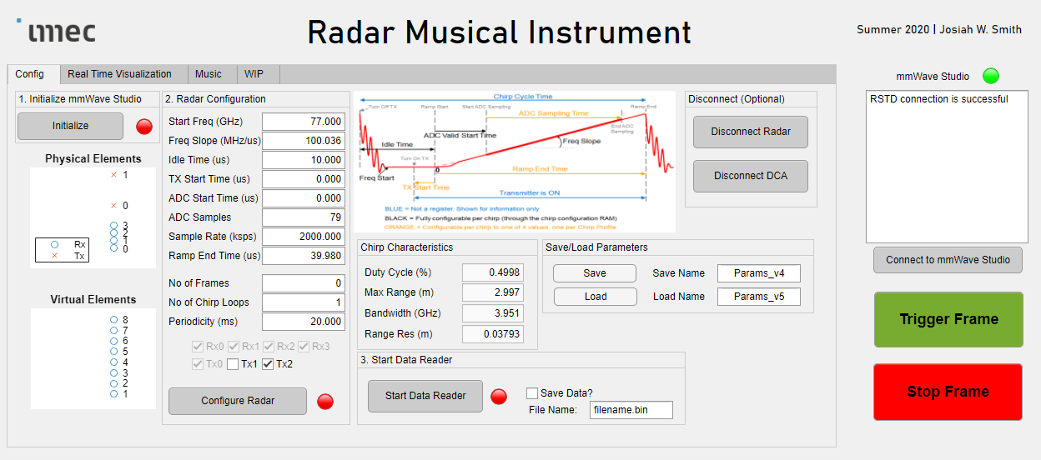
Step 2: Initialize
Establishes connection with radar board

Slide 5
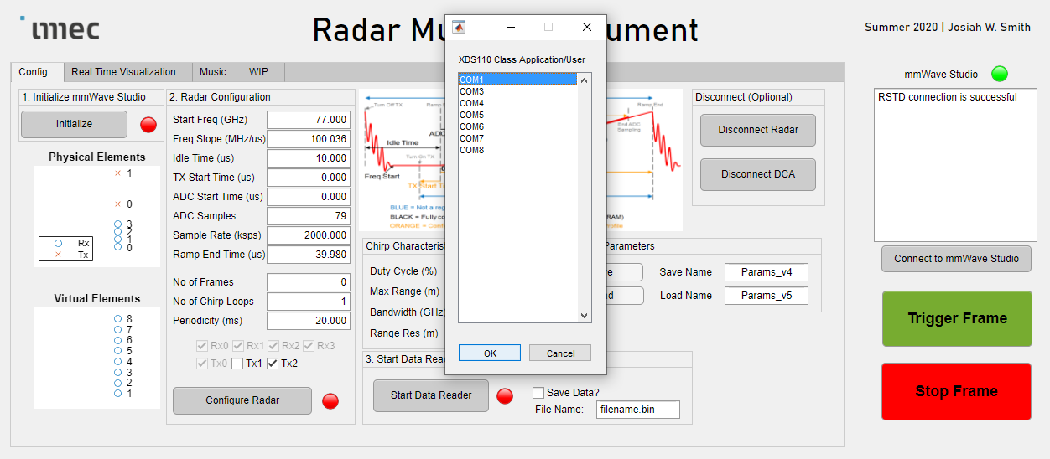
Step 2a: Select COM port
Choose the COM port number with the name “XDS110 Class Application/User UART” under Device Manager -> Ports (COM & LPT)

Slide 6
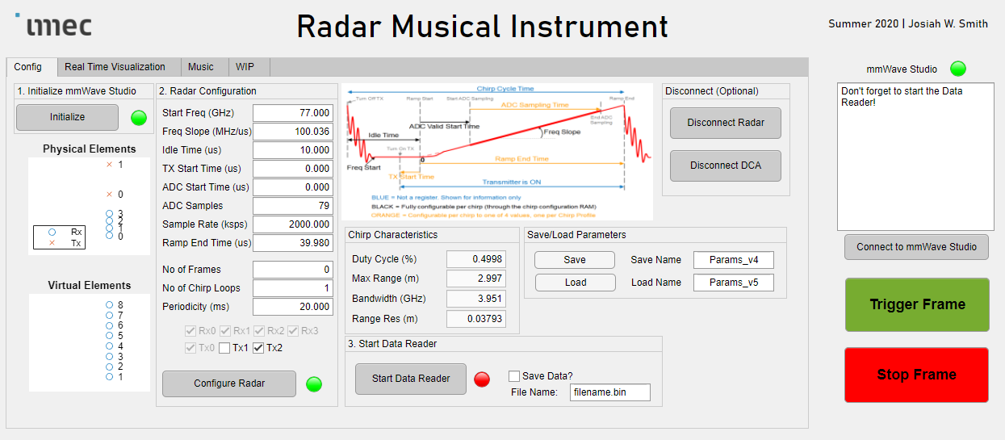
(Optional) Disconnect Radar
- If you want to re-initialize
(Optional) Disconnect DCA
- If you want to re-initialize
If you choose to disconnect, you MUST re-initialize before you can continue!

Slide 7

Wait for green lights

Slide 8
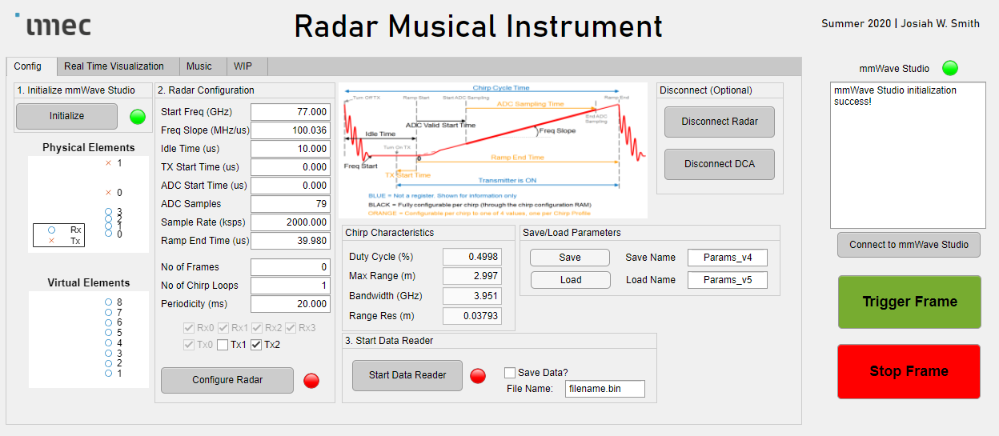
Step 3: Enter/load desired radar chirp parameters
Helpful info on your chirp parameters
Save your current radar parameters
Name to save to
Name to load from
Load previously saved parameters
Step 4: Configure radar
Set number of frames to 0 for infinite streaming

Slide 9
Step 4 (Optional): Start data reader
If you do not start the data reader, mmWave Studio will save the file to “RMI_MATLAB_GUI\data\realTimeData_Raw_0.bin”
Want to save the data collected from the data reader?
Name of bin file, saved to “RMI_MATLAB_GUI/data/”

Slide 10

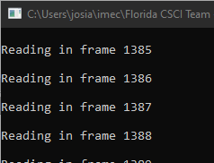
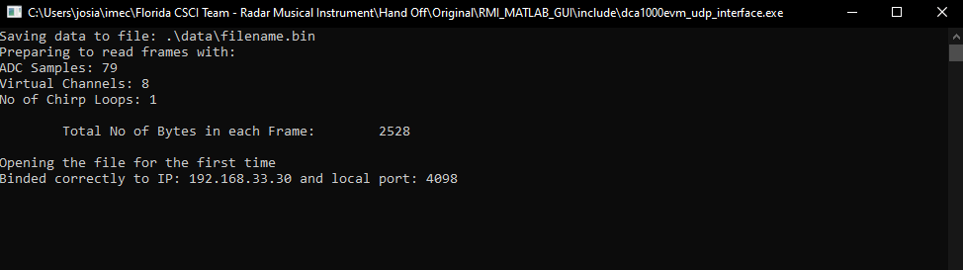
Start streaming the frames
If you are using the data reader, it will show the frames as they come in real-time:
Stop the capture
Data reader console application
You are now ready for real-time music or visualization

Slide 11
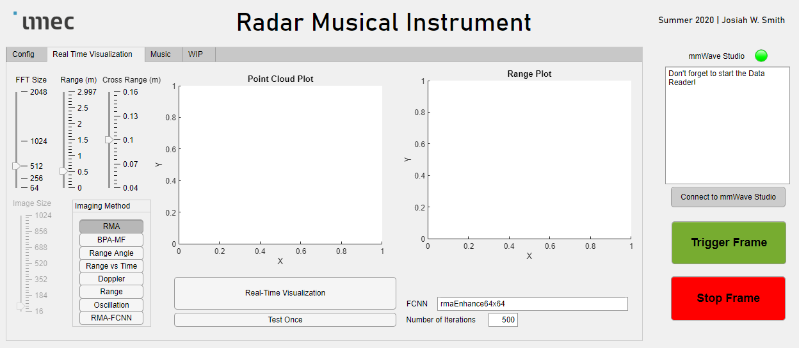
Real Time Visualization Tab
Maximum cross-range
In this example the cross-range domain will be [-0.1,0.1]
Which FCNN to use for enhancement
Maximum Range
Number of FFT bins
What would you like to see in real-time?
Run until stopped (by pressing again, to disengage)
Run for a certain number of iterations
Number of iterations for small test

Slide 12
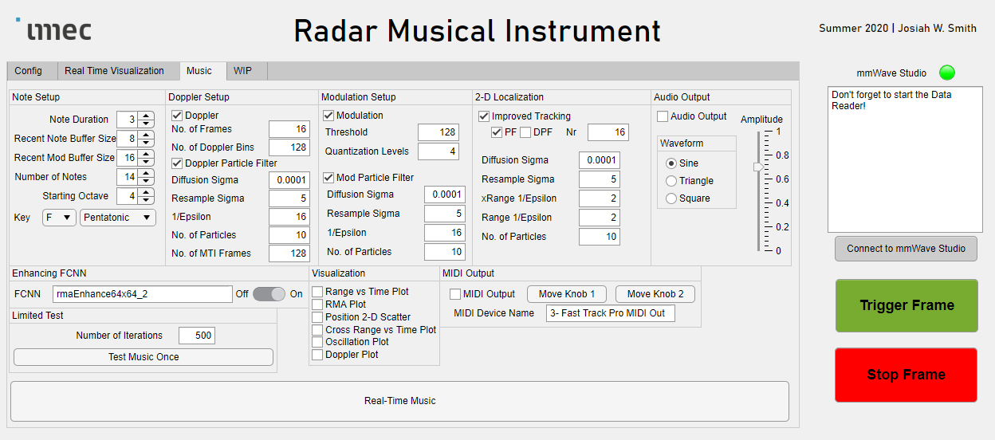
Size of the recent note buffer (if you have a smaller number of notes, it can change notes more easily as it takes the mode of the recent notes to choose the current note)
How long to output the current note to audio or MIDI
Do you want to use Doppler?
Do you want to use the particle filter to track Doppler?
How many frames to use for the Doppler NUFFT
Size of the recent modulation buffer (changes how easily modulation can change)
Number of Doppler NUFFT bins (recommended: 32)
How many notes would you like in your scale
Which octave to have the first note (4 is the middle of the piano)
Select key for audio or MIDI output
Scale type

Slide 13
Use improved tracking?
Output via Audio?
Amplitude of outputted audio
Number of frames for DPF
Type of audio waveform
Use PF or DPF
Standard deviation used for particle diffusion
1/ε weighting for the cross-range
Standard deviation used for resampling
1/ε weighting for the range
Number of particles for the localization particle filter
Output via MIDI?
Move MIDI knob 1 so you can see it moving in your DAW
Move MIDI knob 2 so you can see it moving in your DAW
Name of your MIDI device
Use MATLAB mididevino() to find

Slide 14
Do you want to use modulation?
Threshold to activate modulation
Number of modulation quantization levels
Standard deviation used for particle diffusion
Standard deviation used for particle diffusion
Standard deviation used for resampling
Standard deviation used for resampling
1/ε weighting for the Doppler
Number of particles for the cross-range oscillation particle filter
1/ε weighting for the cross-range oscillation
Number of particles for the Doppler particle filter
Number of frames for the MTI filter (recommended: 4)

Slide 15
Show the 2-D position scatter
Show the range vs time plot
Show the real-time RMA image
Standard deviation used for resampling
Which FCNN to use
Number of iterations for the small test
Test the live music only a few iterations
Show the cross-range vs time plot
Show the real-time Doppler FFT plot and Doppler vs time plots
Show the oscillation plot
Run until stopped (by pressing again, to disengage)

